Slide 1

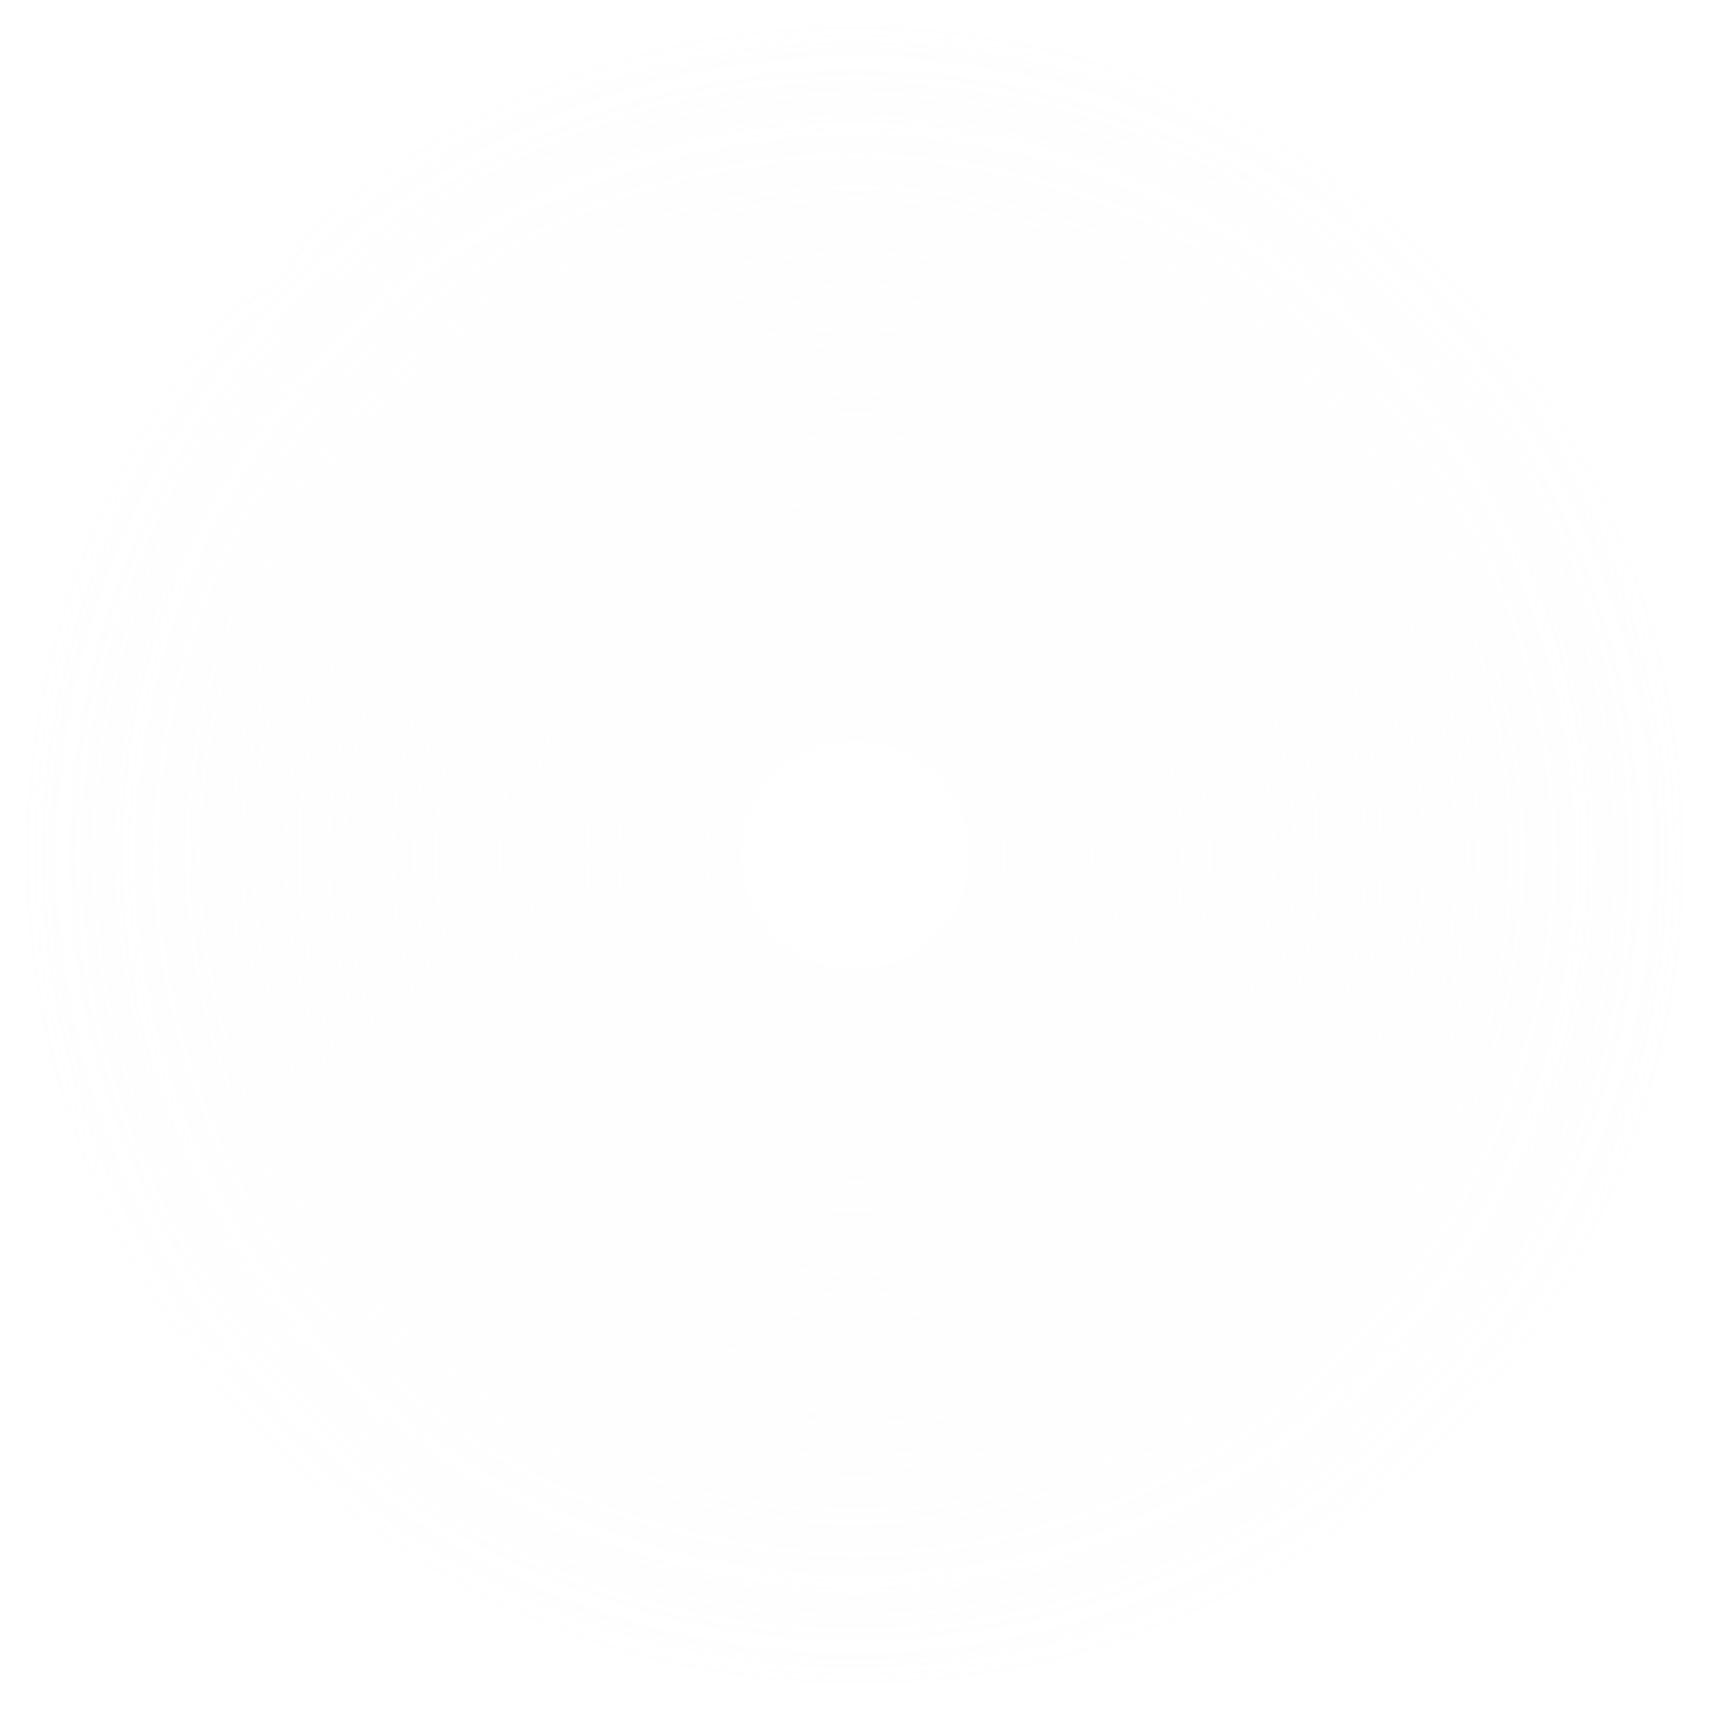

22AIE114- INTRODUCTION TO ELECTRICAL AND ELECTRONICS ENGINEERING
22AIE115- USER INTERFACE DESIGN
ENERGY THEFT DETECTION AND POWER CONSUMPTION MONITORING OF ELECTRICAL APPLIANCES IN SMART GRID
GROUP- 5
•Anakha S- CB.SC.U4AIE24006
•Chaithanya G Nambiar-CB.SC.U4AIE24013
•Surabhi Saha-CB.SC.U4AIE24057
•Sriram S - CB.SC.U4AIE24066

Slide 2
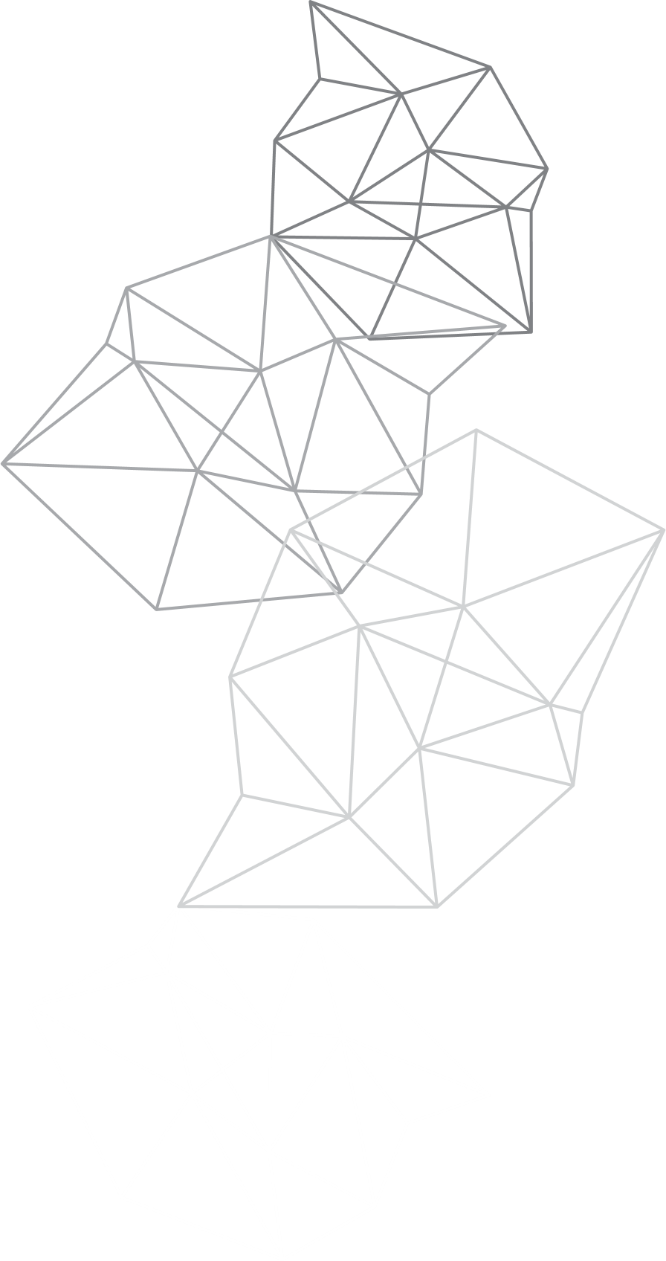
INTRODUCTION
introduction
📈 Rising electricity demand and complex grids require smarter solutions for efficient energy monitoring and management.
⚡ This project builds a Smart Grid Energy Monitoring System that simulates household appliance-level power usage and detects anomalies like energy theft and grid faults using machine learning.
📊 The system uses realistic simulations and interactive visualizations to help users easily understand and analyze energy consumption patterns.

Slide 3
OBJECTIVES
To develop a simulated smart grid environment based on real-world patterns.
To monitor and analyze energy consumption at the appliance level.
To detect anomalies like energy theft and faults in the grid using machine learning.
To visualize energy data using Streamlit dashboards for real-time monitoring and analysis.
To train and apply models like Random Forest and XGBoost for regression and anomaly classification.

Slide 4
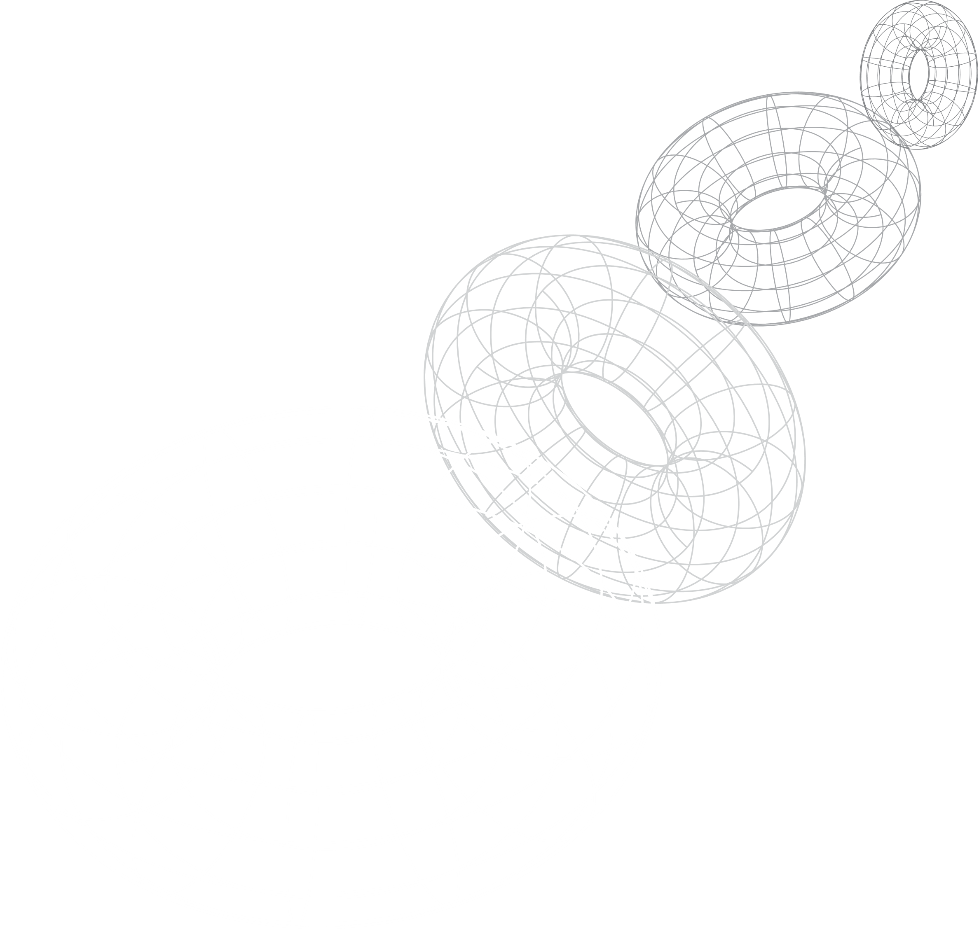
PROBLEM STATEMENT & SOLUTION
⚠️ Traditional energy systems lack the ability to monitor individual appliance usage or detect unauthorized energy consumption (like theft)
🔍 There's limited visibility into faults and power quality issues due to the absence of real-time, detailed data and analytics.
🛠️ This project solves these gaps by using data science techniques to simulate and analyze energy behaviors, enabling smart monitoring and actionable insights through interactive visualizations.

Slide 5
METHODOLOGY

Slide 6
NILM using CNN + BiLSTM Model
CNN (Convolutional Neural Network)
Extracts spatial features or local patterns (e.g., spikes, appliance signatures) from power data.
Recognizes ON/OFF events and patterns in short time windows.
BiLSTM (Bidirectional Long Short-Term Memory)
Captures long-term dependencies in both forward and backward directions.
Understands temporal behavior, like when and how long appliances are used.
How They Work in NILM
Input: The model takes the aggregate power signal (total power from the main meter).
CNN Layer: Detects appliance-specific power patterns from the total signal, acting as "fingerprints".
BiLSTM Layer: Tracks the timing and duration of appliance usage, distinguishing between similar patterns with different timings.
Output: Predicts individual appliance consumption, breaking down the total signal into separate streams.
Why CNN + BiLSTM Works Well for NILM
CNN identifies what appliance is active (pattern).
BiLSTM determines when and how long it's active (timing).
Together, they provide accurate appliance-level monitoring using only the total power data.

Slide 7
1. NILM (Non-Intrusive Load Monitoring)
Uses a single meter to monitor individual appliances’ power usage.
No extra sensors — relies on analyzing voltage/current patterns.
🔌 Appliance-Level Monitoring
NILM breaks down total power by identifying:
Spikes/drops during ON/OFF events
Usage patterns over time
Electrical signatures unique to each appliance
🕵️‍♂️ Partial Bypass Detection
If a device (e.g., fridge) is powered outside the meter, NILM still detects its activity.
Mismatch between detection and meter = suspected theft.
Parameter Normal Bypass Case
Meter Reading Includes fridge Excludes fridge
NILM Detection Fridge is ON Fridge is ON
Conclusion Normal Suspicious – Theft
⚙️ Why NILM Helps
Detects mismatch between appliance activity and meter data
Repeated mismatches trigger power theft alerts
✅ Benefits
No manual inspection
Detects small-scale theft
Enables smart energy monitoring

Slide 8
Autoencoder:
Purpose: Learns efficient data representations for tasks like anomaly detection.
Architecture: Composed of an Encoder (compresses data) and a Decoder (reconstructs data).
Use in Energy Theft Detection: Identifies unusual power consumption patterns by detecting reconstruction errors.
GRU (Gated Recurrent Unit):
Purpose: A type of RNN that models time-series data with gates controlling information flow(gates help decide which information to keep and which to forget as the model processes time-based data).
Use in Energy Theft Detection: Predicts normal energy consumption patterns and identifies deviations that may signal theft.
Combined Approach:
Autoencoder detects anomalies, while GRU predicts time-series patterns, both working together to identify energy theft.

Slide 9
2. Energy Theft Detection — Key Features & Indicators
Energy theft causes discrepancies between what’s actually consumed and what’s reported by the meter. These features help detect such anomalies:
🔋 Power-Based Indicators
total_power vs actual_power
Theft causes a gap between actual appliance usage and meter readings.
power_factor
Power factor = Real Power / Apparent Power.
Tampering (e.g., with phase angle) can artificially lower the real power reading.
⚡ Voltage & Current Analysis
voltage, current
Tampering can lead to abnormal voltage-current relationships (e.g., bypassed circuits or added loads).
⚙️ Power Quality Metrics
apparent_power = Total power in the system (real + reactive).
reactive_power = Power that oscillates (not consumed).
Selective manipulation (e.g., capacitor banks) affects these, indicating theft.
harmonic_distortion (THD)
Electrical theft (esp. via electronics) introduces harmonics — irregular waveforms — which increase THD.

Slide 10
🧠 Machine Learning Features
theft_factor, theft_flag (ground truth labels)
Indicators/labels for the XGBoost model to learn from.
theft_flag = 1 when theft is confirmed in training data.
⏰ Time-Based Features
hour, day, is_weekend
Theft often happens during low-surveillance times — like weekends or late nights.
📊 Power Ratios (Derived)
power_current_ratio = total power / current
power_voltage_ratio = total power / voltage
apparent_real_ratio = apparent power / real power
These quantify inconsistencies in power behavior — theft often disturbs normal ratios.

Slide 11
Smart Grid Fault Detection
voltage
→ Voltage sag/swell is a primary grid anomaly
frequency
→ Deviation from 50Hz indicates generation-load imbalance
harmonic_distortion (THD)
→ Indicates waveform distortion, often due to faulty equipment
power_factor
→ Deviates during unstable grid conditions (e.g., capacitor loss)
apparent_power, reactive_power, current
→ Their fluctuations signal load instability or transient faults
fault_flag, fault_severity, fault_type (ground truth)
→ Used for supervised labeling in XGBoost (XGBoost is a smart machine learning method that combines many small decision trees to make better and more accurate predictions)

Slide 12
Voltage Nominal Deviation
→ Measures how far actual voltage is from the expected value, helping detect subtle anomalies.
Frequency Nominal Deviation
→ Tracks deviation from 50Hz to quickly catch imbalances before they become serious faults.
THD Ratio
→ Normalizes total harmonic distortion to compare against standard thresholds and highlight unusual waveform behaviors.
Temperature
→ High temperatures may indicate or cause thermal stress in components, leading to faults, especially in transformers and cables.
Hour / Day
→ Many faults are time-related, occurring during peak load hours or scheduled maintenance; this helps capture seasonal or time-based patterns.

Slide 13
DATASET DETAILS
Rows: 3,365
Columns: 19
Purpose: To monitor and analyze energy usage, voltage stability, and power quality in households for applications like fault detection or energy optimization.
🗂️ Key Features:
Timestamp: Date and time of the measurement
House ID: Unique identifier for each house
⚡ Electrical Parameters:
total_power, voltage, current, apparent_power, reactive_power
power_factor: Efficiency of power usage
frequency: Should be ~50Hz in stable conditions
harmonic_distortion: Indicates waveform distortion
🌡️ Environmental:
temperature: Ambient condition affecting load
🏠 Appliance-specific Power Usage:
Power consumed by:
refrigerator, washing_machine, dishwasher, microwave, television, lighting, air_conditioner, computer

Slide 14
METRICS USED IN THE PROJECT
Mean Absolute Error (MAE): Measures the average absolute difference between predicted and actual energy usage, indicating overall prediction accuracy.
Mean Squared Error (MSE): Penalizes larger errors more than MAE by squaring the differences, helping to identify big prediction mistakes.
Root Mean Squared Error (RMSE): Gives error in the same unit as the target variable, making it easier to interpret how far predictions are from actual values.
Precision: Indicates how many detected anomalies were actually true faults or thefts, focusing on the correctness of positive predictions.
Recall: Measures how many of the real anomalies were successfully detected by the model, emphasizing completeness.
Accuracy: Represents the overall percentage of correct predictions made by the model, including both normal and faulty instances.

Slide 15
RESULT
We developed a Streamlit-based interactive dashboard that simulates and monitors smart grid energy behavior across multiple households.
For Non-Intrusive Load Monitoring (NILM), we implemented a CNN + BiLSTM model to disaggregate appliance-level energy usage from total consumption.
Energy Theft Detection was handled using an Autoencoder + GRU model, which successfully identified abnormal consumption patterns indicating possible theft.
We also introduced Smart Grid Fault Detection using the Autoencoder + GRU model, detecting faults like voltage sags/swells, frequency deviation, and harmonic distortion.
The dashboard supports real-time visualization, appliance-wise analysis, and fault/anomaly heatmaps, offering clear insights into both normal and abnormal grid behavior.
The system demonstrates effective use of deep learning for predictive analytics and anomaly detection in smart grids.

Slide 16
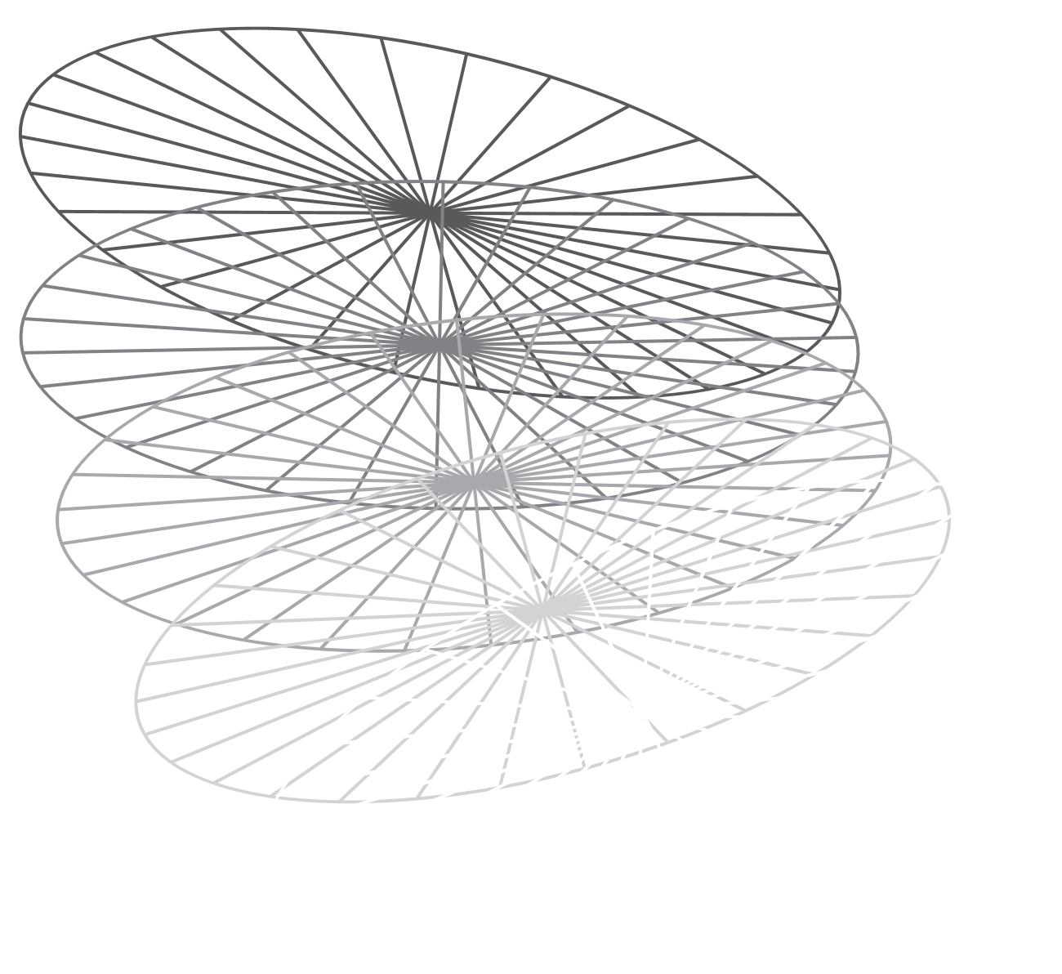
CONCLUSION
The dataset provides a comprehensive view of household energy consumption along with key power quality metrics.
It enables detection of anomalies, such as voltage/frequency deviations, faulty appliance behavior, and inefficient power usage.
With this data, machine learning models like Autoencoder, GRU, and XGBoost can be trained to perform smart grid fault detection and energy optimization.
Overall, it is a valuable resource for building intelligent systems that ensure a stable, efficient, and secure smart grid.

Slide 17
REFERENCES
H. Liu, C. Liu, L. Tian, H. Zhao and J. Liu, "Non-intrusive Load Disaggregation Based on Deep Learning and Multi-feature Fusion," 2021 3rd International Conference on Smart Power & Internet Energy Systems (SPIES), Shanghai, China, 2021, pp. 210-215, doi: 10.1109/SPIES52282.2021.9633819. keywords: {Deep learning;Couplings;Load monitoring;Correlation;Power demand;Energy;Smart grids;deep learning;non-intrusive load disaggregation;electricity consumption correlation;multi-feature coupling}
M. Devlin and B. P. Hayes, "Non-Intrusive Load Monitoring using Electricity Smart Meter Data: A Deep Learning Approach," 2019 IEEE Power & Energy Society General Meeting (PESGM), Atlanta, GA, USA, 2019, pp. 1-5, doi: 10.1109/PESGM40551.2019.8973732. keywords: {Non-intrusive load monitoring;load disaggregation;energy disaggregation;smart metering;appliance identification;machine learning}
F. Afzoon, H. Shahinzadeh, M. Moazzami, W. Yaïci, A. Karimi and F. Ebrahimi, "Enhancing Fraud Detection in Transactive Energy Markets: Investigating the Impact of Data Augmentation on the Performance of Machine Learning and Deep Learning Techniques," 2023 3rd International Conference on Smart Cities, Automation & Intelligent Computing Systems (ICON-SONICS), Bali, Indonesia, 2023, pp. 97-102, doi: 10.1109/ICON-SONICS59898.2023.10435147. keywords: {Deep learning;Support vector machines;Data augmentation;Data models;Fraud;Security;Random forests;Fraud detection;Transactive Energy Markets;Data augmentation;Deep learning;Machine learning},

Slide 18
THANK YOU

